Slide 1
LINE FOLLOWER

Slide 2
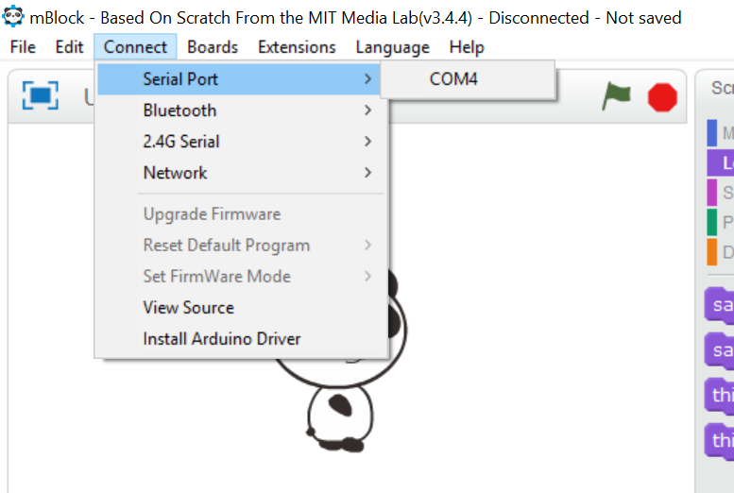
STEP 1. launch your Mblock
Start your mBlock application in your computer
Connect your mBlock to your computer using the USB cable.
Select Connect > Serial Port > COM4

Slide 3
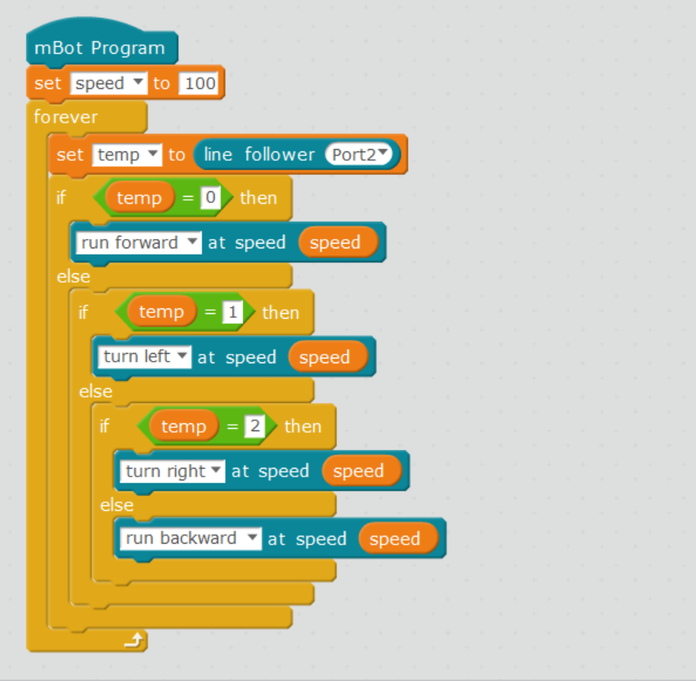
STEP 2.a WRITE the Program
This program uses the light sensors that attached to your mBot to differentiate between black and white.
Using the tools from the Events, Controls and Robot section, write the following code
To complete this program, you need to know what is a variable and how to cerate one.

Slide 4
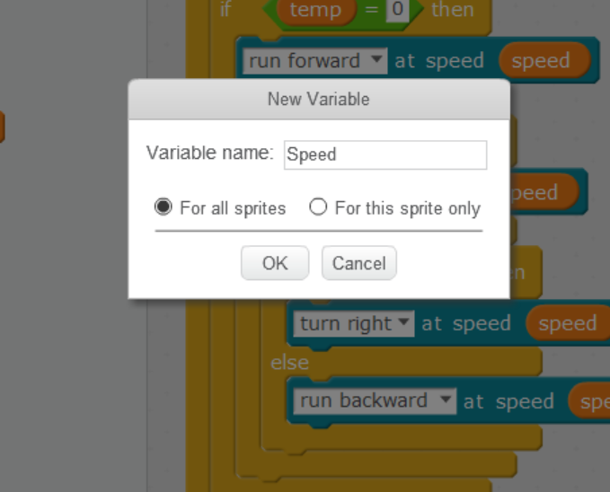
STEP 2.b HOW to Create variables ?
Variables are the ones, whose values are can be assigned during run-time. More about this later.
To create a variable, go to ‘Data & Blocks’ > Make a variable
Give the variable as ‘Speed’, you can name it as you wish

Slide 5
STEP 2.b HOW to Create variables ? (CONTINUE)
Follow the same steps and create another variable, ‘temp’
Now, use these two variables and complete the program

Slide 6
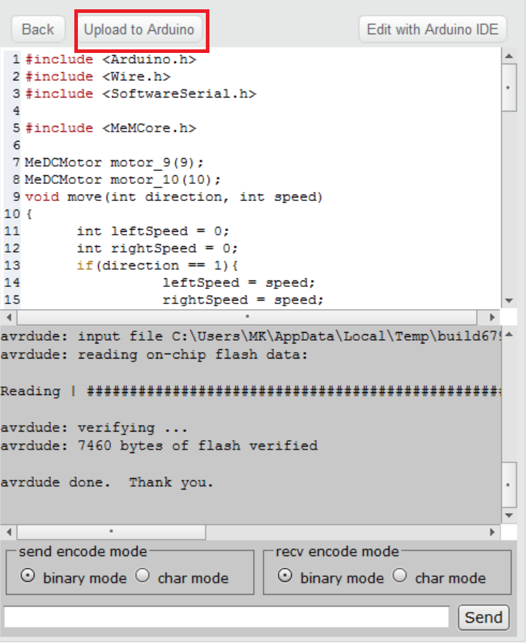
STEP 3: Upload the program
Press anywhere on the program, a new screen will open from the right side of the application
Now, press Upload to Arduino
When the uploading is done, press finish
Disconnect the USB cable and switch off the lights to see your mBot follow the black line !!

